Slide 1

Predictor of Acid Dissociation Constants
Cristian Crișan

Slide 2
TABLE OF CONTENTS
01
02
INTRODUCTION
DATA COLLECTION
03
04
MODEL TRAINING
RESULTS
Project overview and Problem statement
Preprocess data with feature selection
Model arhitecture and training process
Discussion about the output and conclusion

Slide 3
01
INTRODUCTION

Slide 4
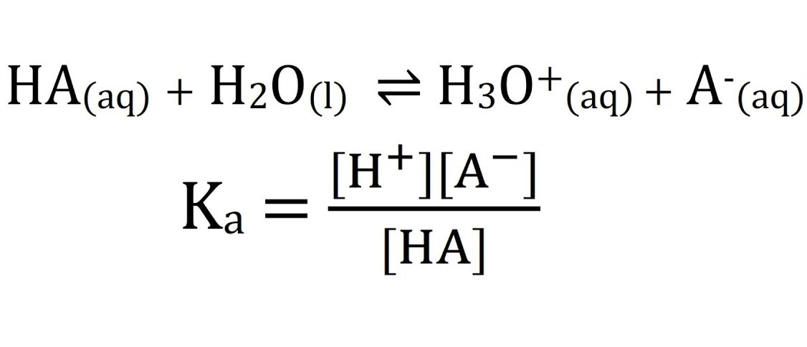
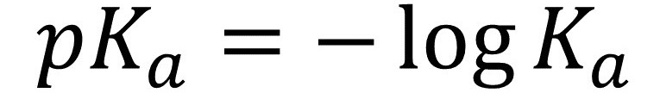
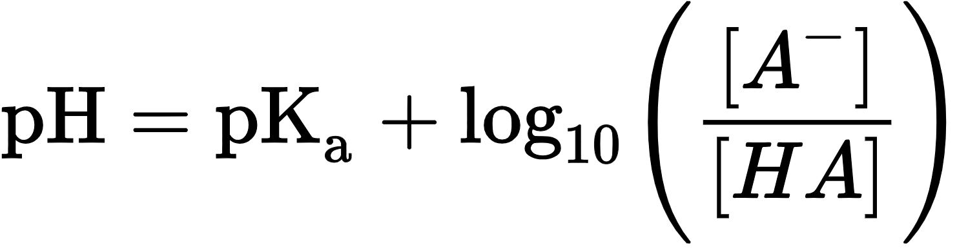
INTRODUCTION
First, we need to:
Define the problem
Importance of the project
Applications of the Acid Dissociation Constant

Slide 5
02
DATA COLLECTION

Slide 6
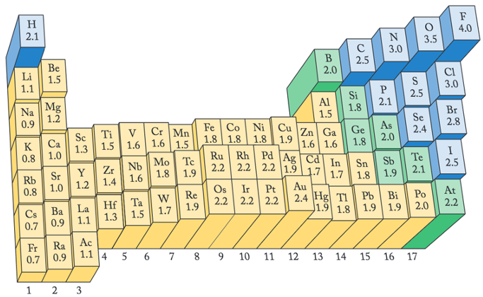
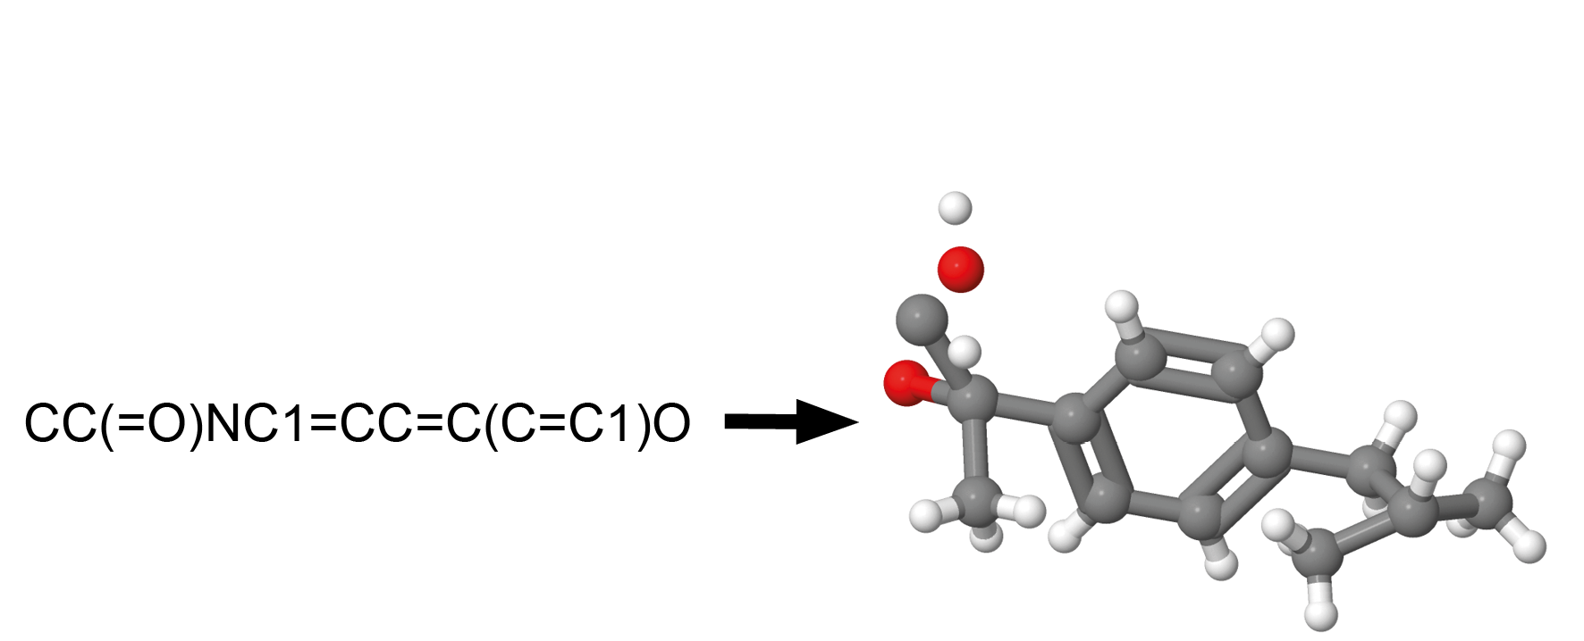
DATA COLLECTION
Source: IUPAC Database
Molecules: SMILES notation was used
pKa Values: Collected at 20-25°C for consistency
Molecules Graphs:
Atoms = Nodes (with attributes)
Bonds = Egdes (with attributes)

Slide 7
03
MODEL TRAINING

Slide 8
MODEL TRAINING
Data Processing: Preparing molecular data for neural network use
Data Splitting:
70% for training
15% for validation
15% for testing
The neural network contains:
Linear Layer
GCN Layer (Graph Convolutional Networks)
Layer Normalization
Dropout
Global Mean Pooling

Slide 9
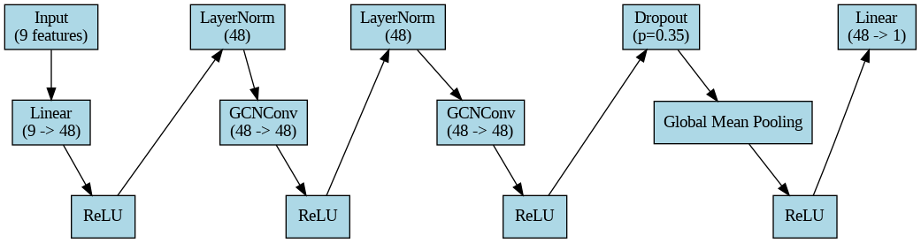
MODEL TRAINING

Slide 10
04
RESULTS

Slide 11
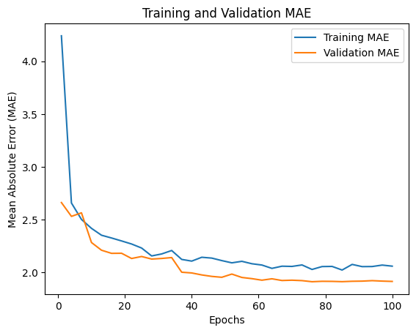
RESULTS
The evaluation metrics used were:
Mean Squared Error (MSE = 6.45)
Mean Absolute Error (MAE = 1.88)
R² Score = 0.3727
Percentage of predicted values within 1-unit tolerance of the true value: 37.3%

Slide 12
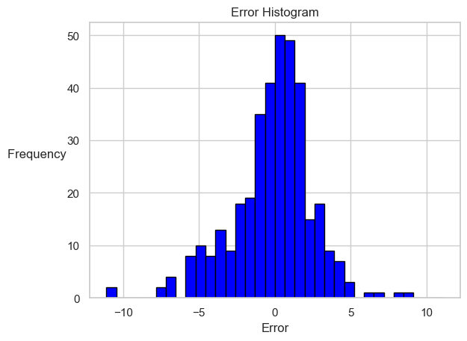
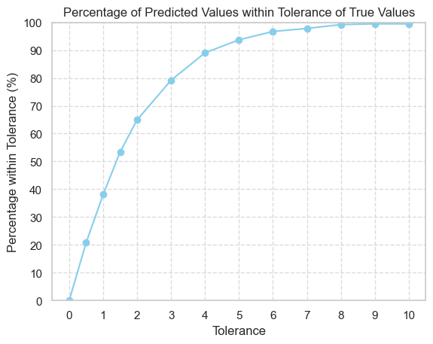
RESULTS AND PERSPECTIVES

Slide 13
THE CONCEPT OF THE EXPERIMENTAL SETUP
Pompă peristaltică cu motor integrat
ARDUINO
pH-metru
Pahar Berzelius cu soluția de substanță X
PC cu analiză în timp real a procesului
Titrare cu B₄O₇⁻ a substanței X

Slide 14
Predictor of First Acid Dissociation Constants
References:
Tantardini C, Oganov AR, Thermochemical electronegativities of the elements, Nat Commun, 2021
Kristin S. Alongi, George C. Shields, Chapter 8 - Theoretical Calculations of Acid Dissociation Constants: A Review Article, Annual Reports in Computational Chemistry, Elsevier, Volume 6, 2010, Pages 113-138
github.com/IUPAC/Dissociation-Constants

Slide 15
THANK YOU FOR YOUR ATTENTION!

